Slide 1

Butler Bootcamp Data Analytics Final Project
Theodore Ofner, Kyle Brumbaugh, Andrew Phillbeck, and Seth Bogue

Slide 2
Selected Topic
Our project will focus on analysing data from the International Movie Database (IMDb)
IMDb is an online database where members can rate movies, tv shows, podcasts, home videos, video games, and online streaming content.

Slide 3
Data Source
IMDb also stores a multitude of data about each individual film in their database and it is available for free online.
The database is massive, containing more than 10 million titles and the website has more than 83 million registered users.

Slide 4
Description of the Data
IMDb data is available to the general public and can be accessed at: https://datasets.imdbws.com.
Data is structured as a network of tables keyed with a unique identifying code for each film.
We are interested in genre, rating, votes, release year, gross revenue, and region of production.

Slide 5
Database
Data was housed in Amazon AWS S3 buckets and was queried using PySpark.
Individual datasets were joined in PySpark and were used to train our machine learning model

Slide 6
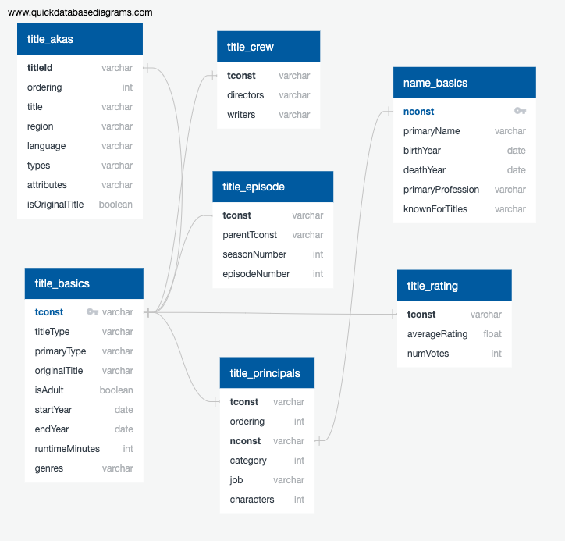
Database Diagram

Slide 7
Questions for Analysis
Do overall ratings change over time?
i.e. - do older films rate better vs newer?
Are there significant differences in ratings between genres?

Slide 8
Questions for Analysis
Does runtime effect ratings?
i.e. - Do longer films rate higher than shorter films?
Can k-means clustering identify any meaningful clustering in the data?
Interpretation of these clusters?

Slide 9
Description of the Analysis
A K Means clustering algorithm was created

